Slide 1
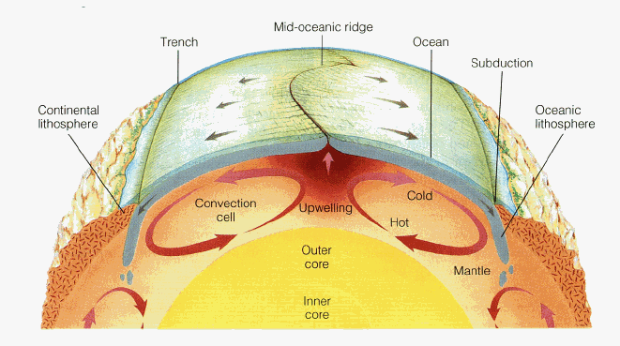
Mantle Convection and Plate Tectonics
UPWELLING beneath spreading ridges
DOWNWELLING beneath subduction zones
THE PLATES surface expression of
mantle convection

Slide 2


Convection in Miso Soup

Slide 3
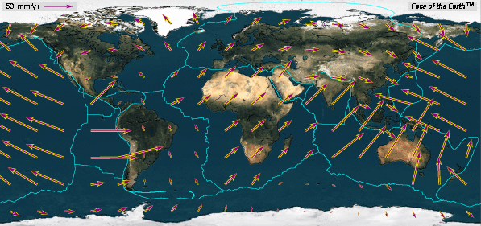
How Fast do the Plates Move?
Plate Speeds
Atlantic Basin: 1-2 cm/yr
Indian Basin: 3-7 cm/yr
Pacific Basin: 5-10 cm/yr

Slide 4
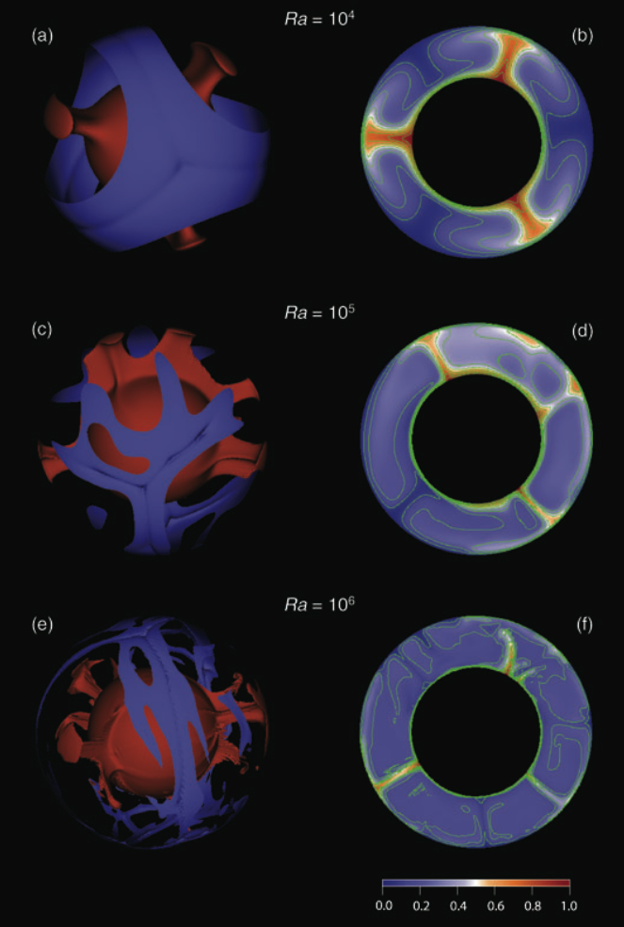
Mantle Convection:
How Vigorous?
Deschamps et al., 2010
The Rayleigh Number
(Ra) measures the vigor
of convection

Slide 5
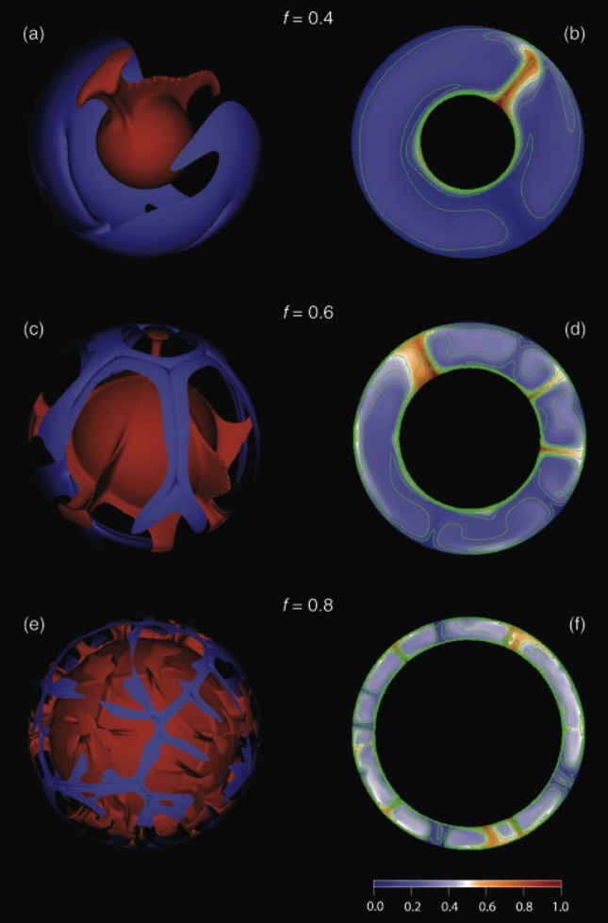
Mantle Convection:
Effect of Core Size
Ra =10⁵
Deschamps et al., 2010
Convection cells form
with an aspect ratio
greater than 1

Slide 6
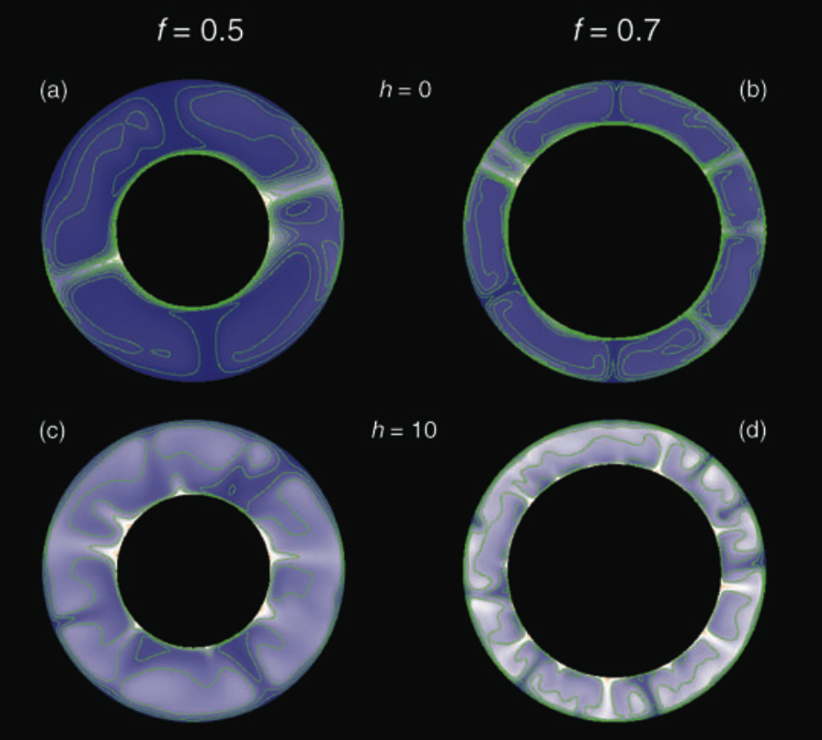
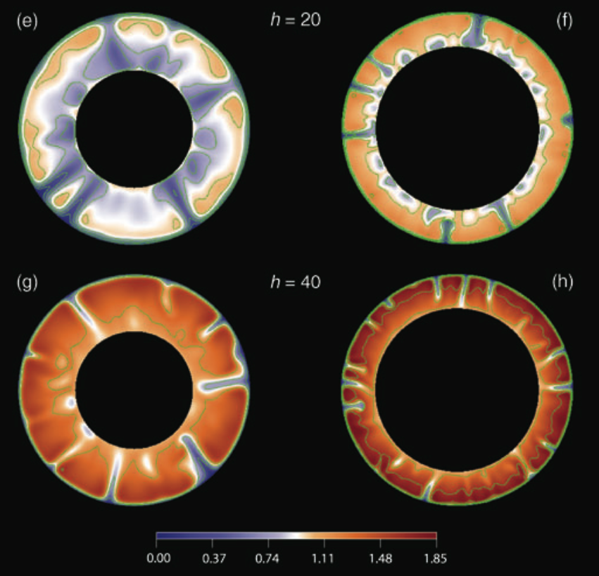
Mantle Convection:
Effect of Internal Heating
Internal heating increases
the importance of the
top boundary layer
(the lithosphere)
Deschamps et al., 2010

Slide 7
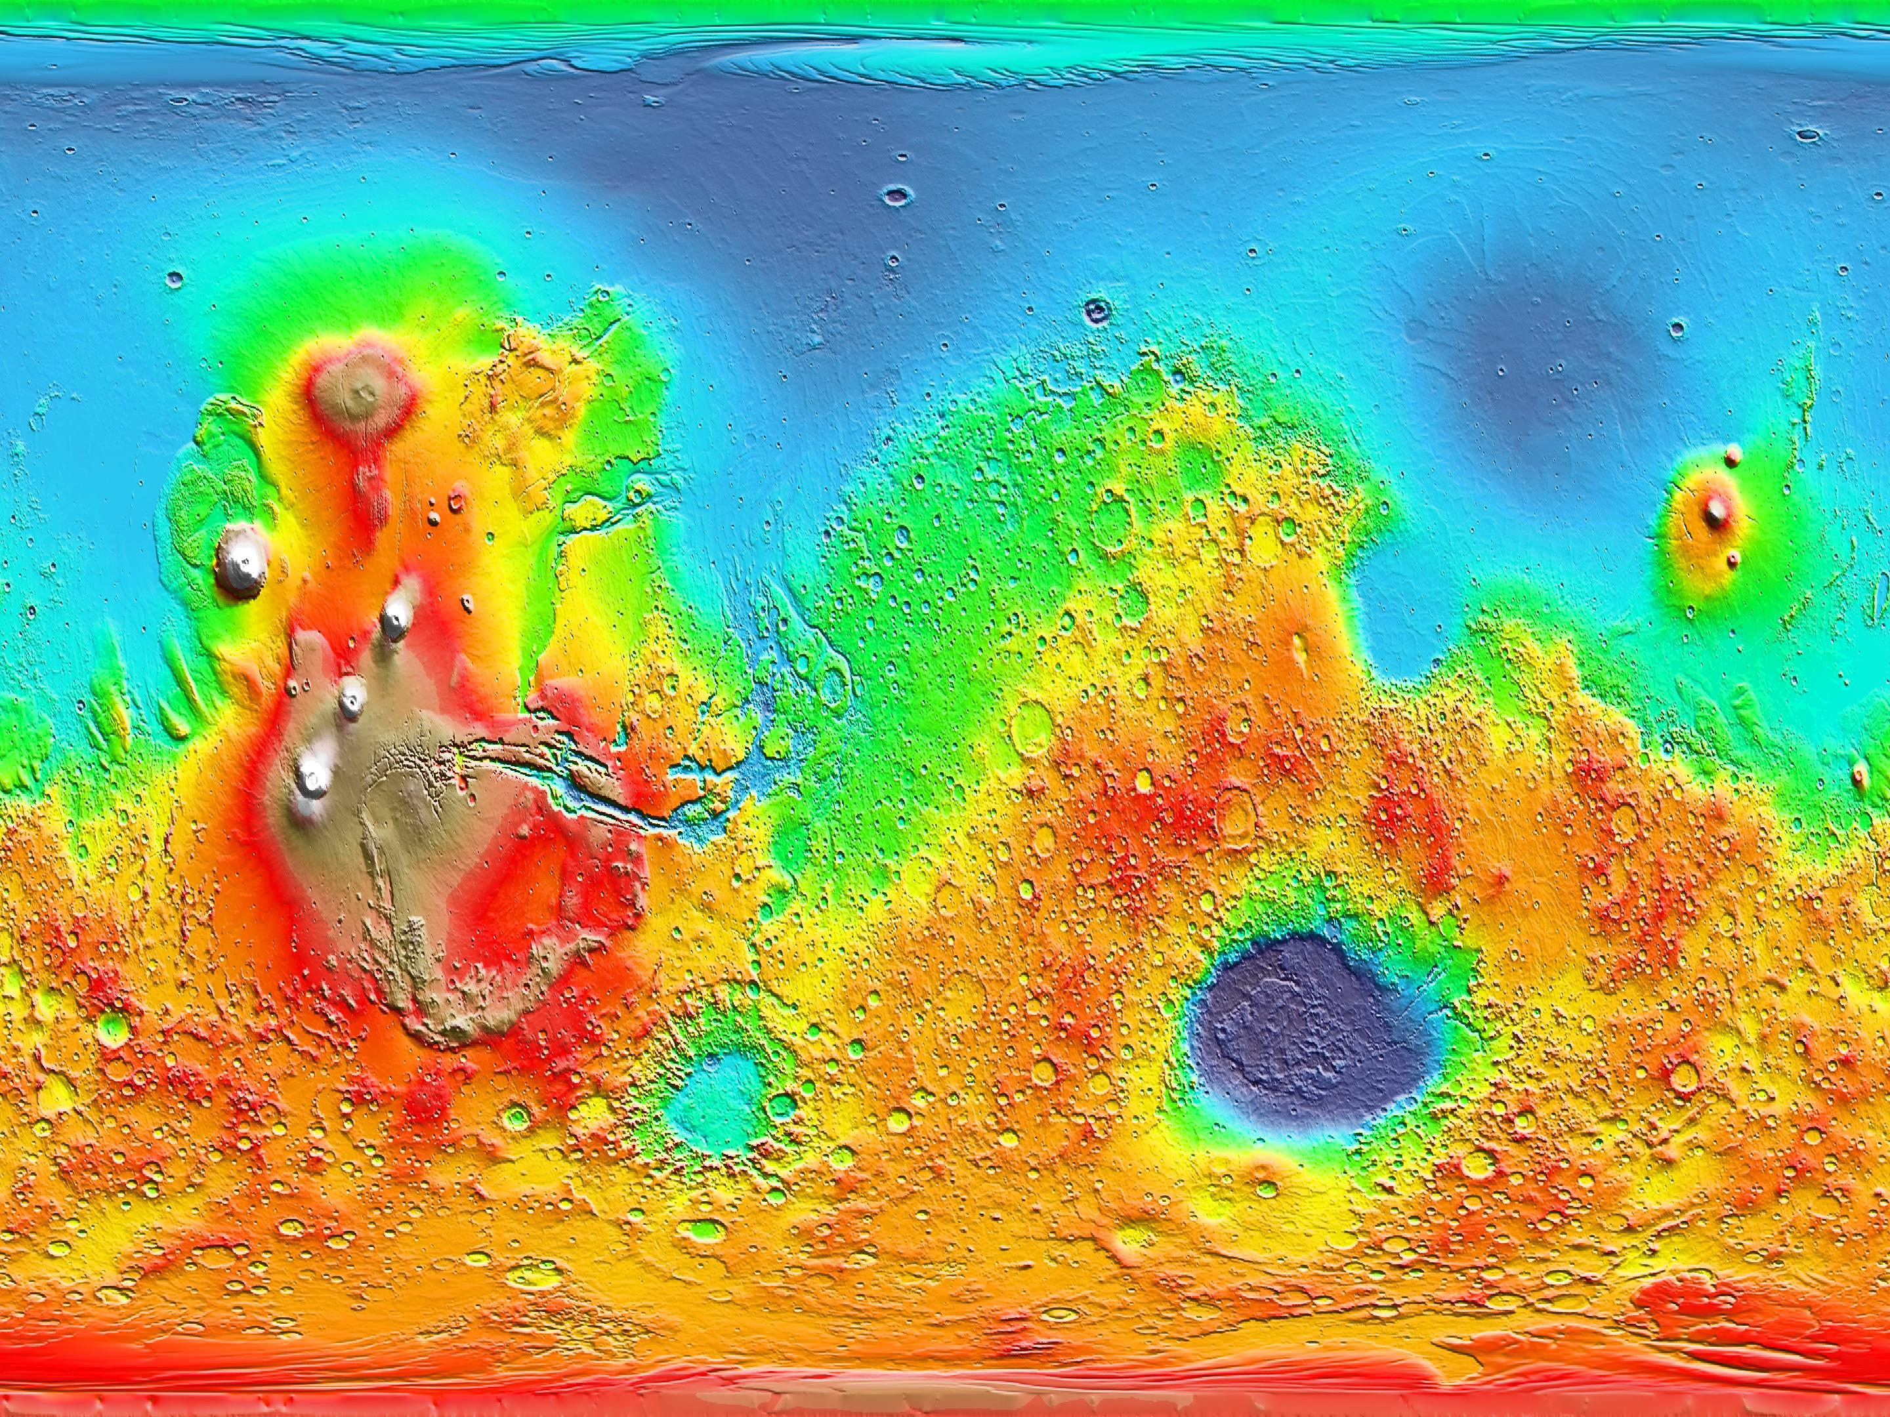
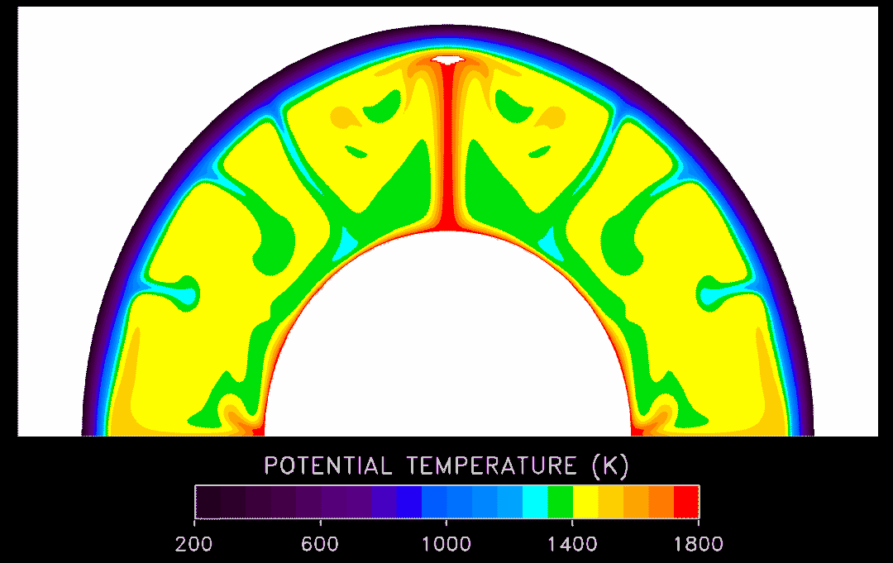
Plate Tectonics and Convection on other Planets?
Moon, Mars, Venus, Mercury: Surfaces are much
older than Earth's: Probably no plate tectonics
Instead, mantle convection may take a different form
Mars Topography
Model of Mars Convection

Slide 8
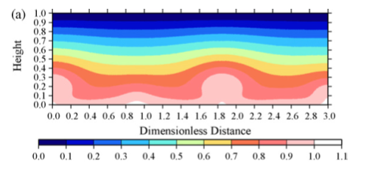
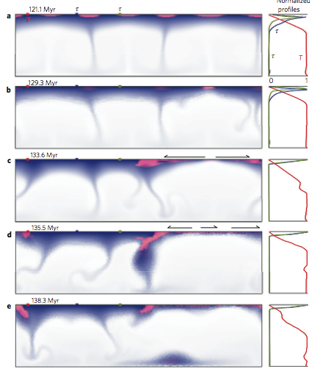
Mercury: Low Ra
Icy convection on Enceladus
Redmond & King 2007
ONeill & Nimmo 2010

Slide 9
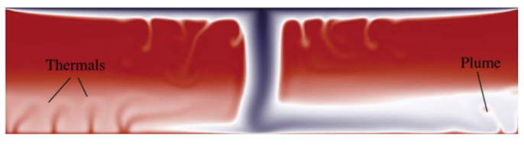
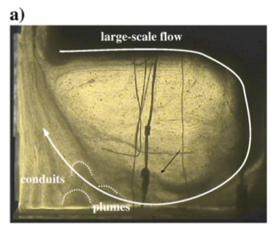
Episodic convection
on Venus
Robin et al., 2007

Slide 10
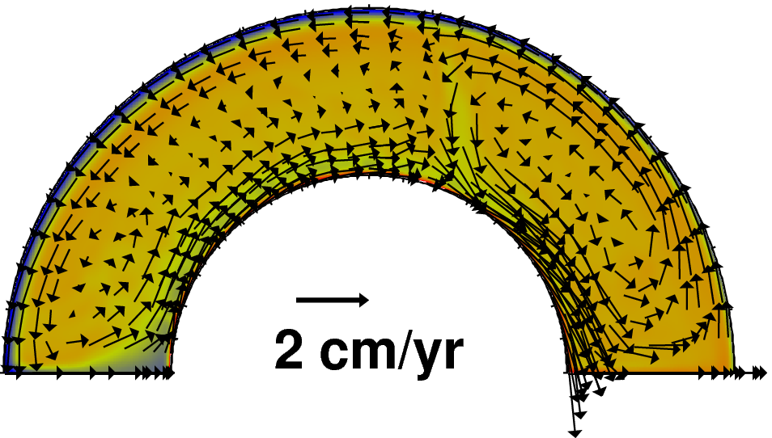
Exoplanets: Tidally-locked example
HOT
SIDE
(star)
COLD
SIDE
(night)
van Summeren, Conrad, & Gaidos, 2011

Slide 11
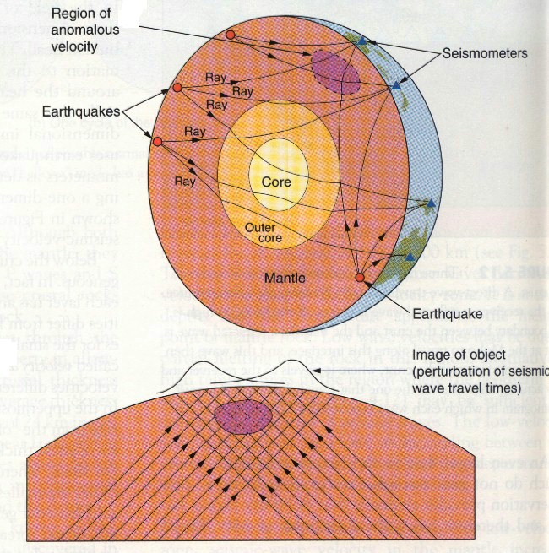
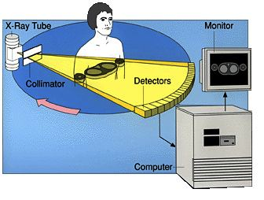
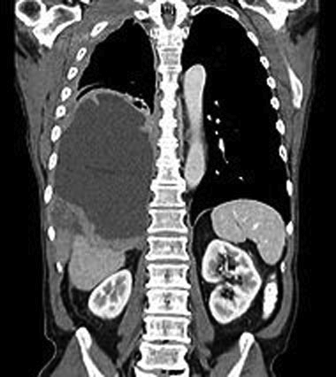
Observing Convection in the Earth: Seismic Tomography
Cat-Scan

Slide 12
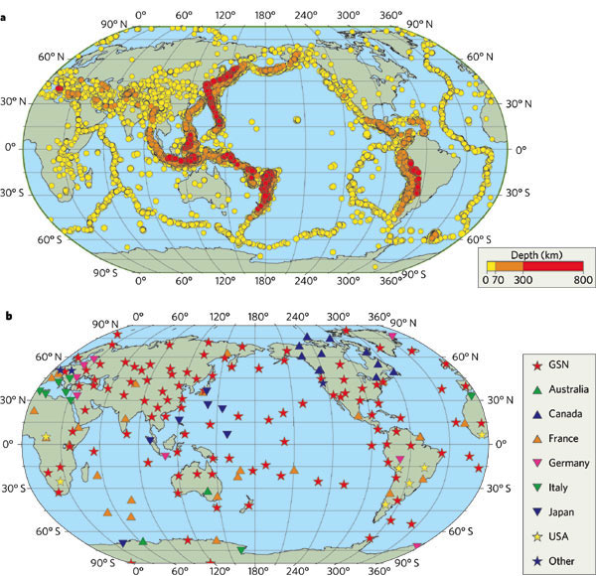

Slide 13
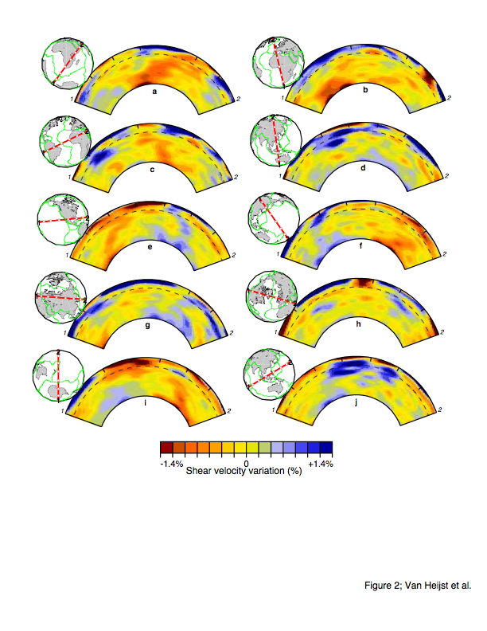

Slide 14
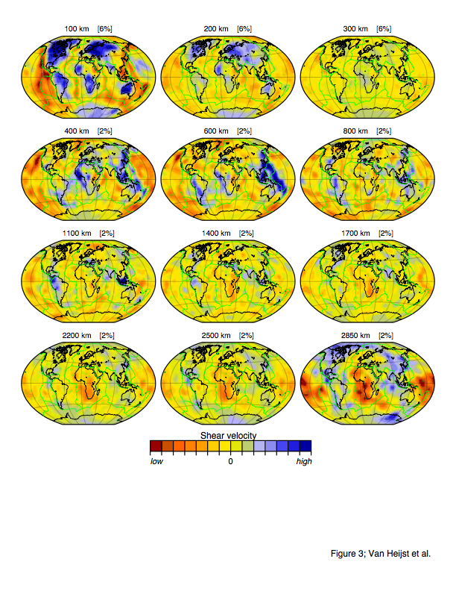

Slide 15
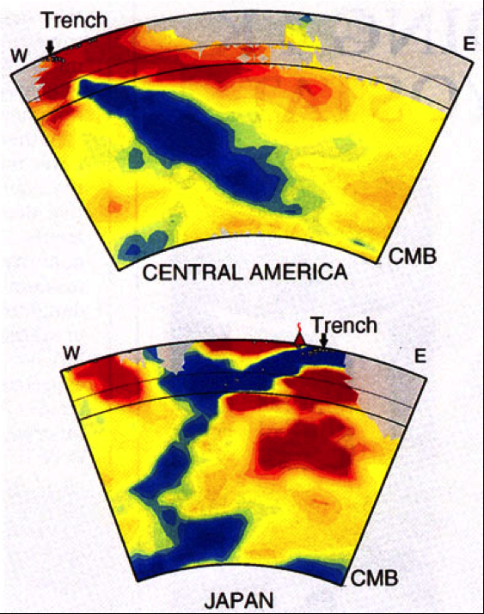
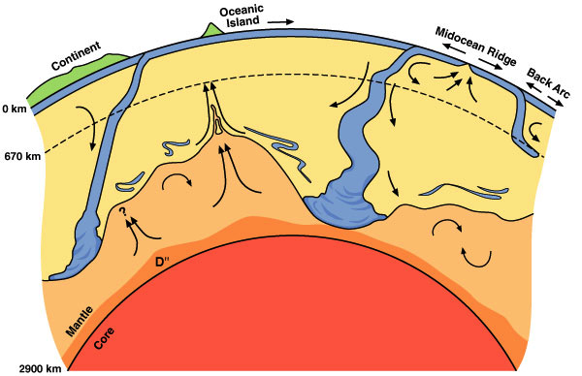
Slabs

Slide 16
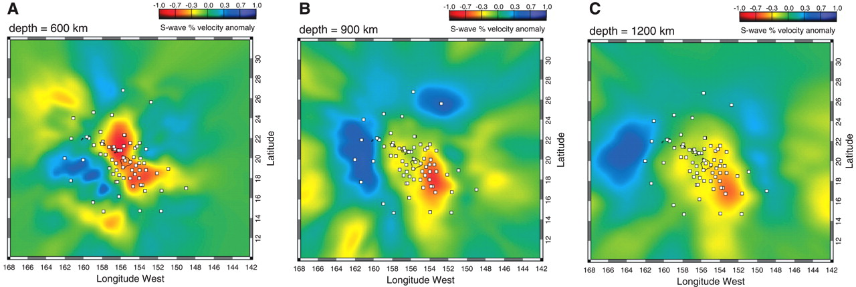
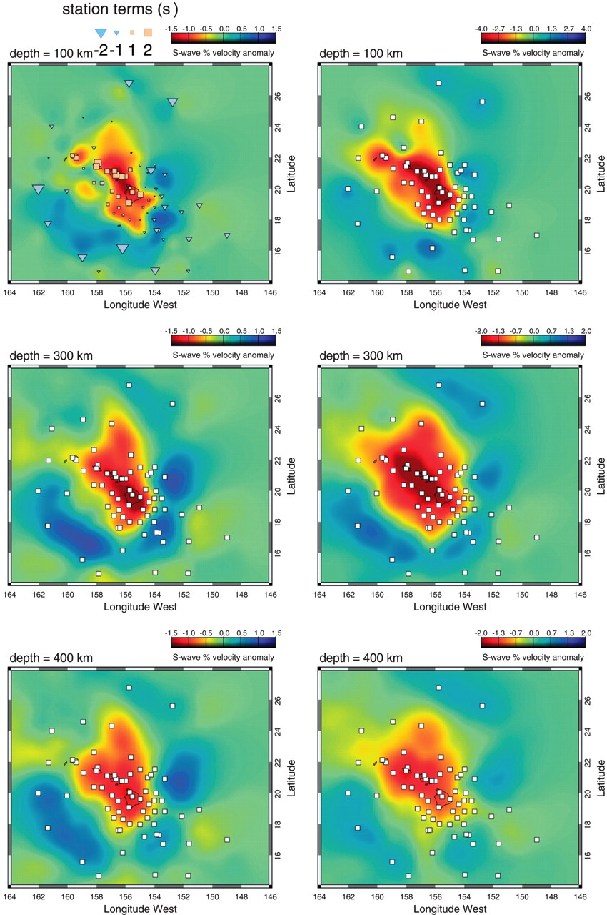
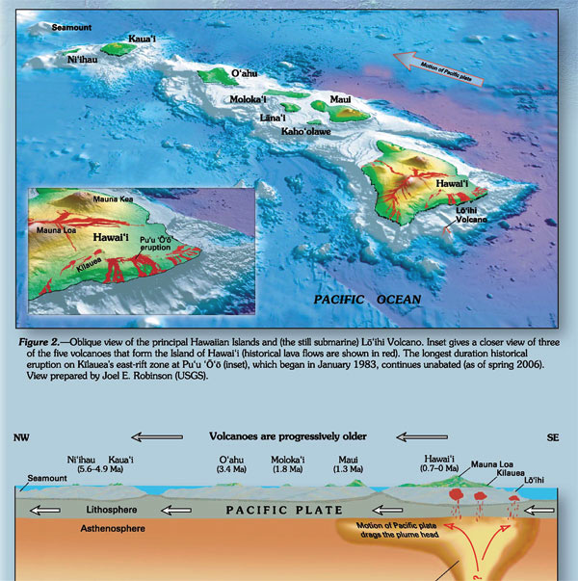
Plumes (Hawaii)
Wolfe et al (2009)

Slide 17
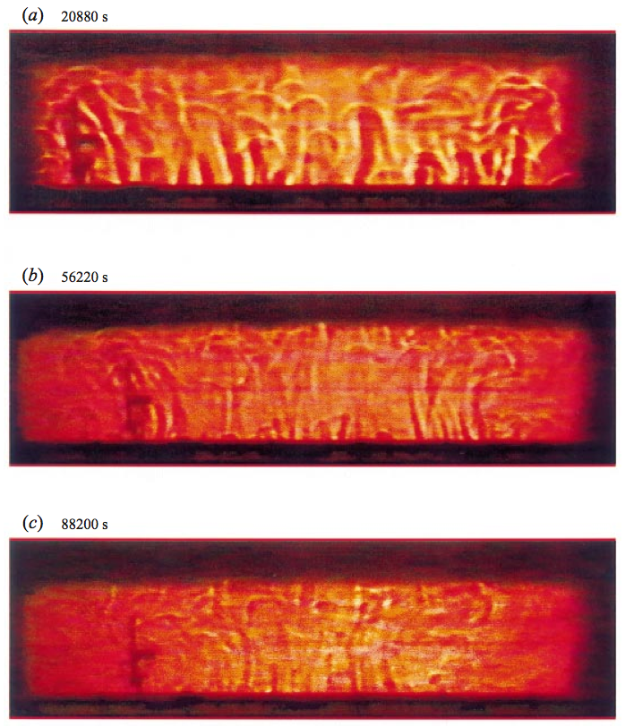
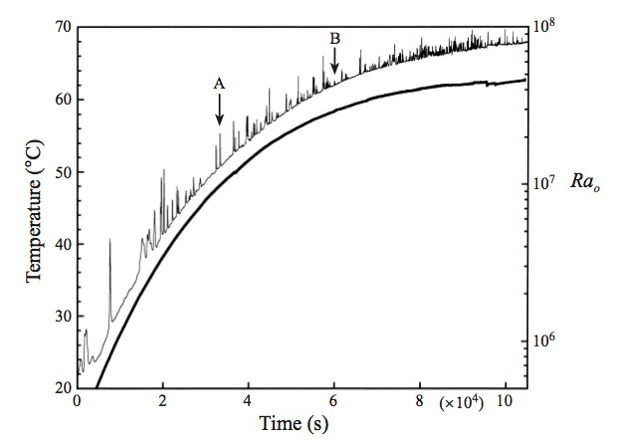
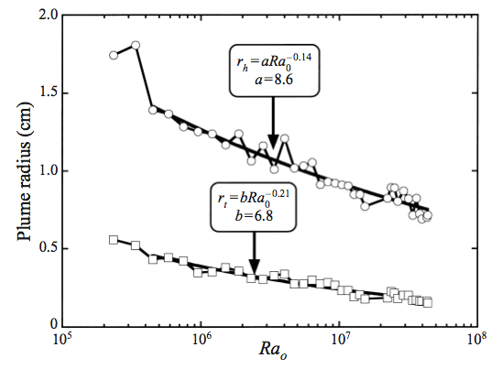
Lithgow-Bertelloni et al. [2001]

Slide 18
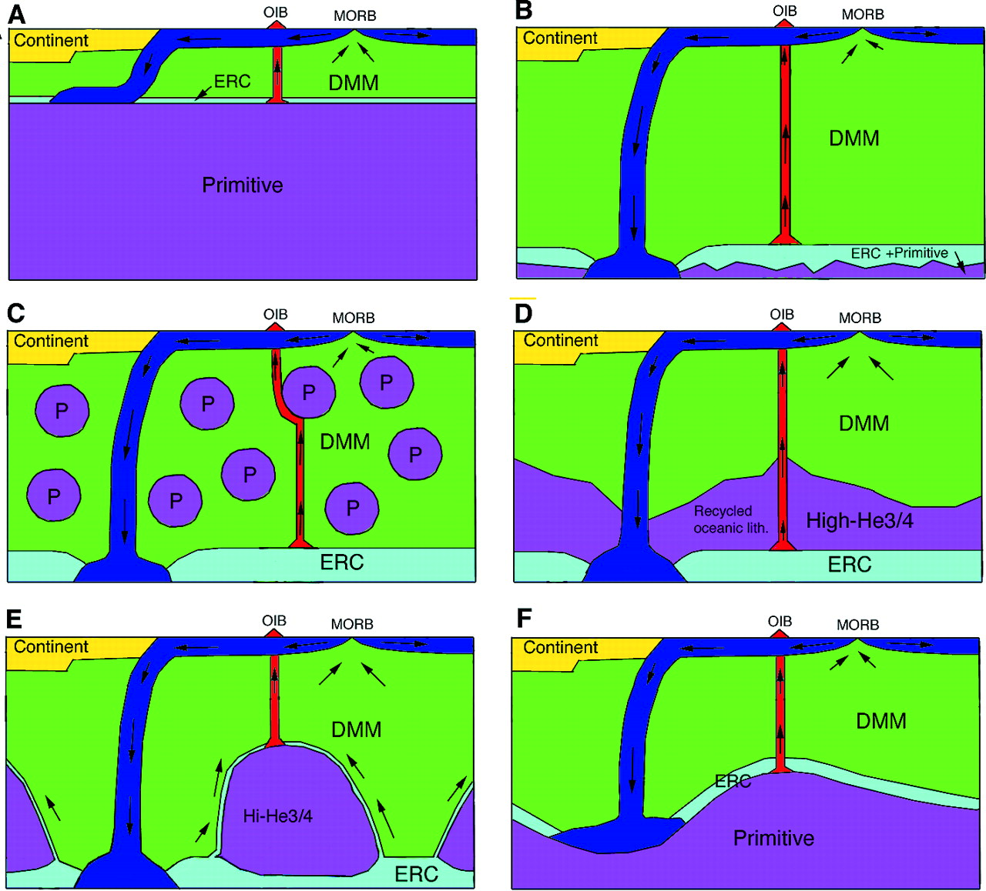
Structure of Mantle Convection
Tackley
[2000]

Slide 19
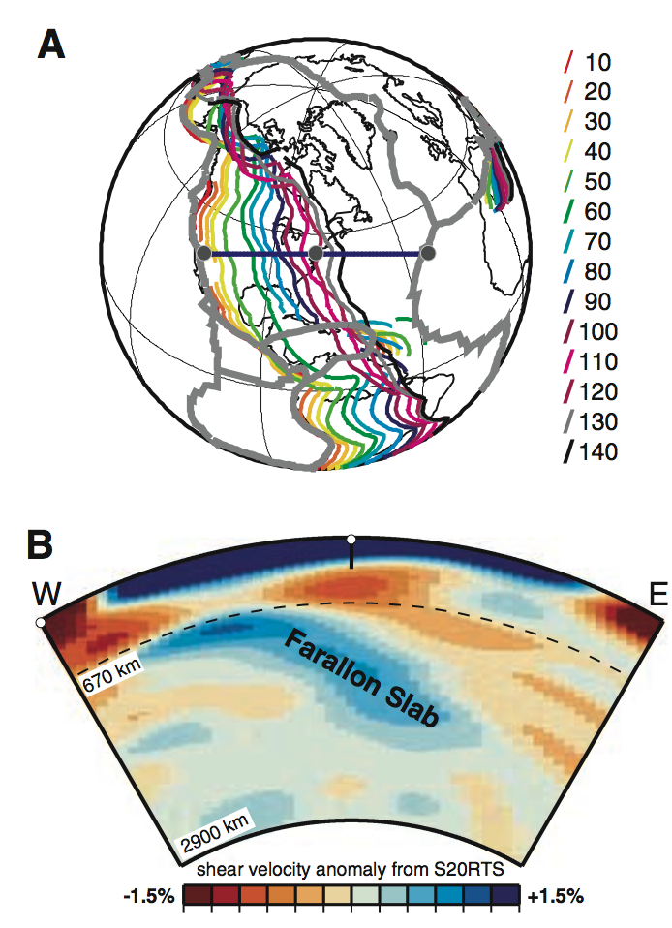
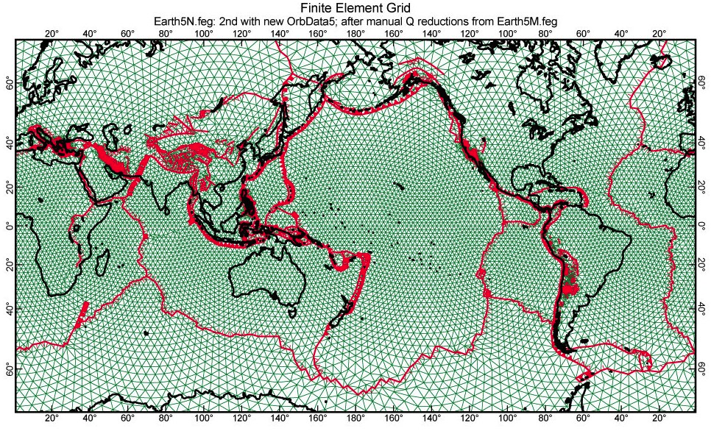
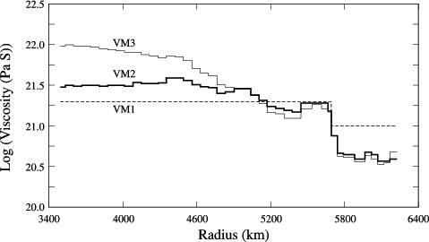
Numerical Models of Mantle Convection
Input:
1. Mantle Densities
(from seismic tomography)
2. Mantle Viscosity Structure
(from postglacial rebound)
3. A Finite Element Code

Slide 20
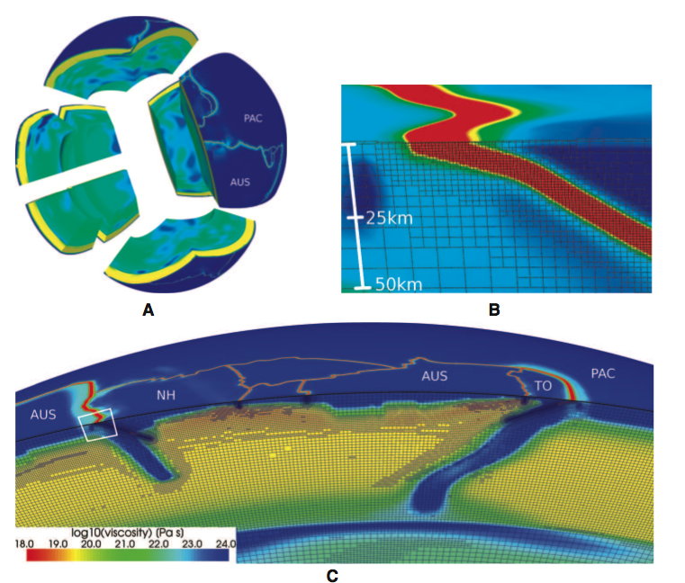
State of the Art: Adaptive Mesh Refinement & Slabs
Stadler et al.,
Science 2010

Slide 21
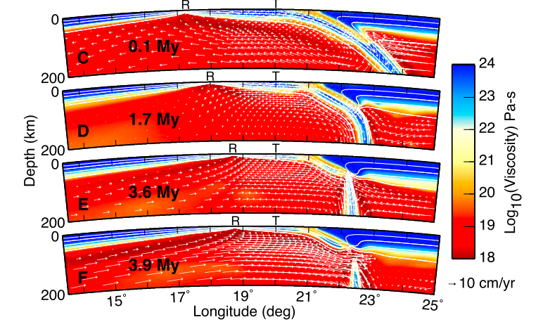
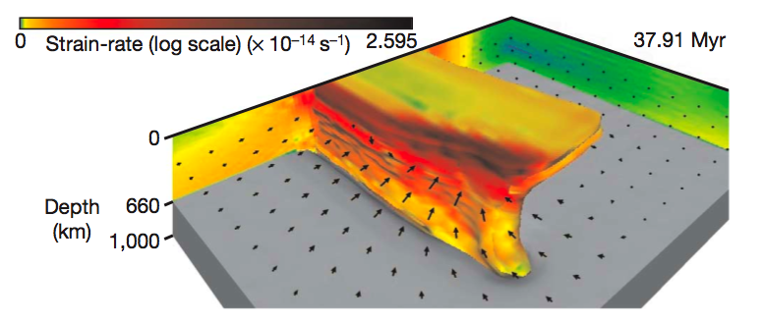
Subduction
and Slabs
form a
crucial part
of convection
on Earth
Burkett &
Billen [2009]
Schellart et al [2007]

Slide 22
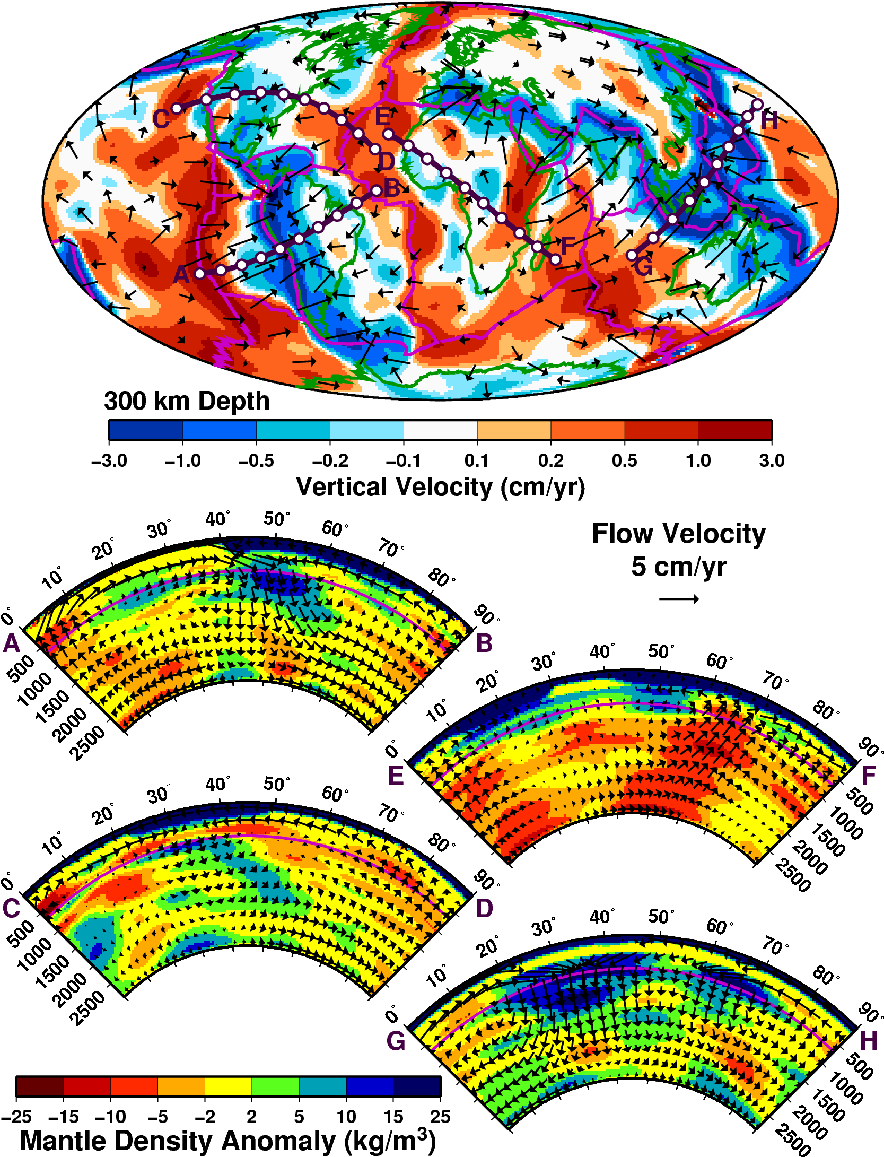
Predictions of Numerical
Convection Models:
Mantle Flow Field

Slide 23
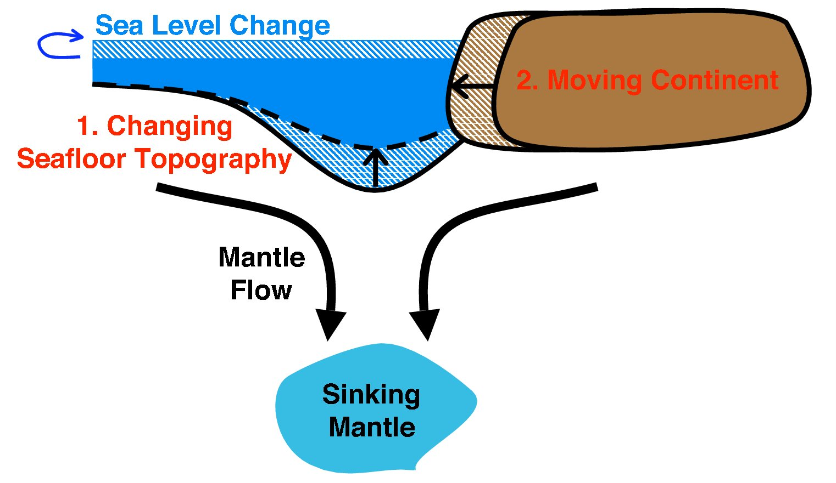
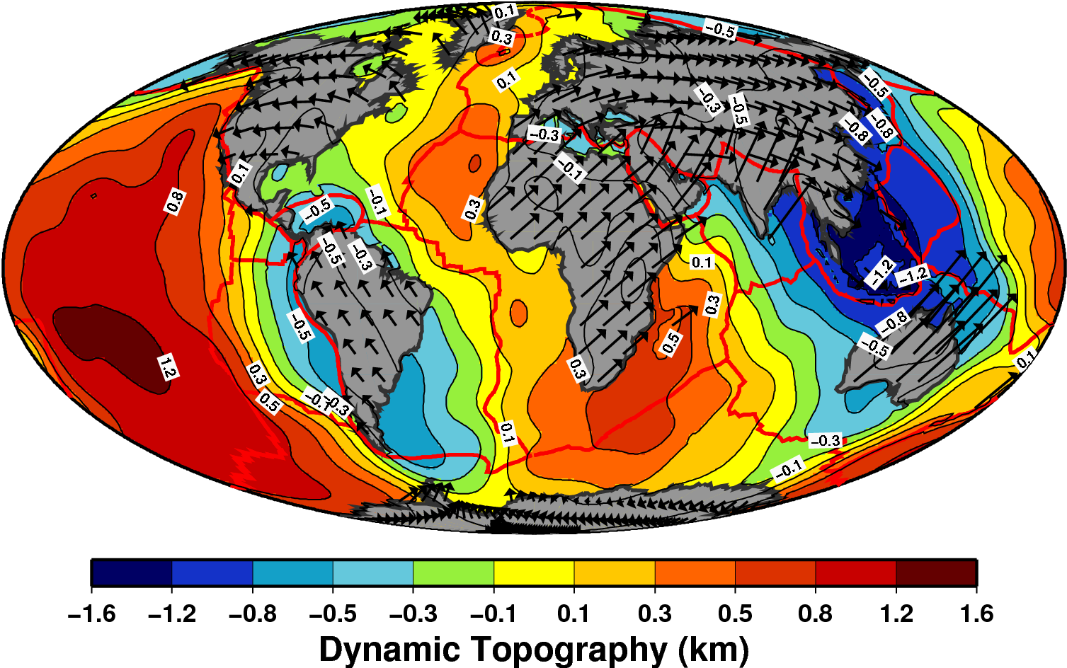
Predictions of Numerical
Convection Models:
Dynamic Uplift
Conrad & Husson, 2009

Slide 24
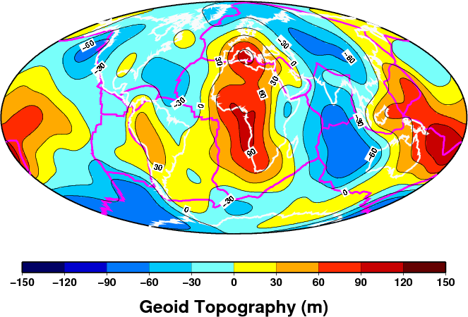
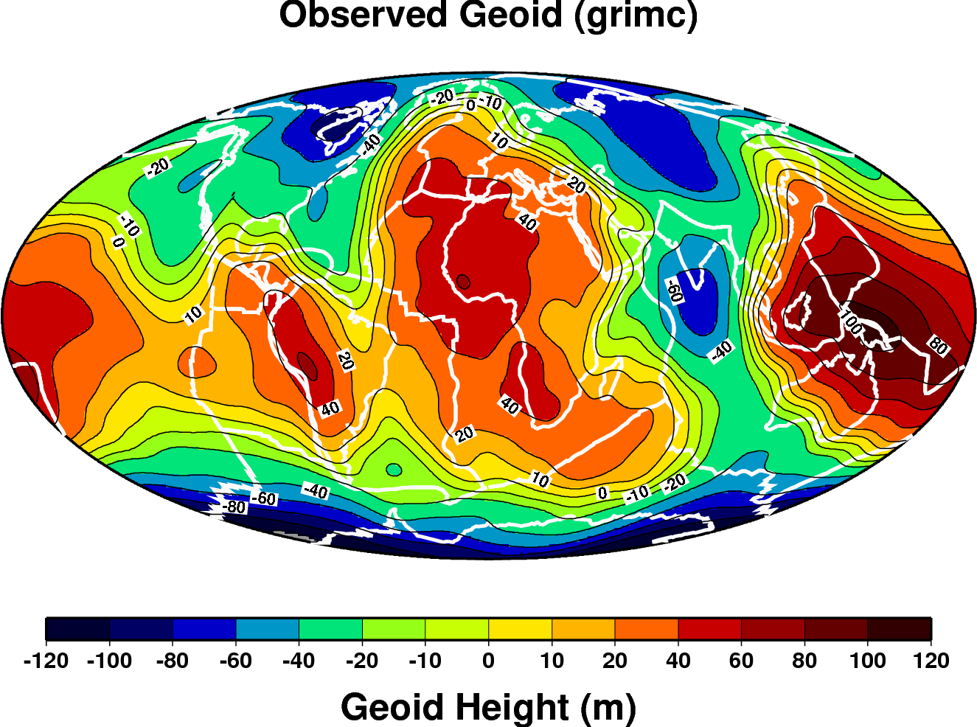
Predictions of Numerical
Convection Models:
Earth’s Shape
(the Geoid)

Slide 25
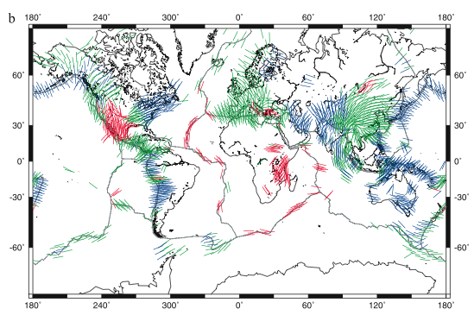
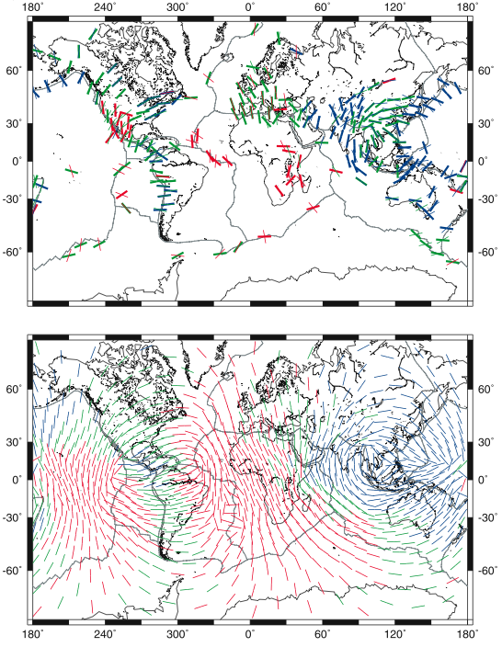
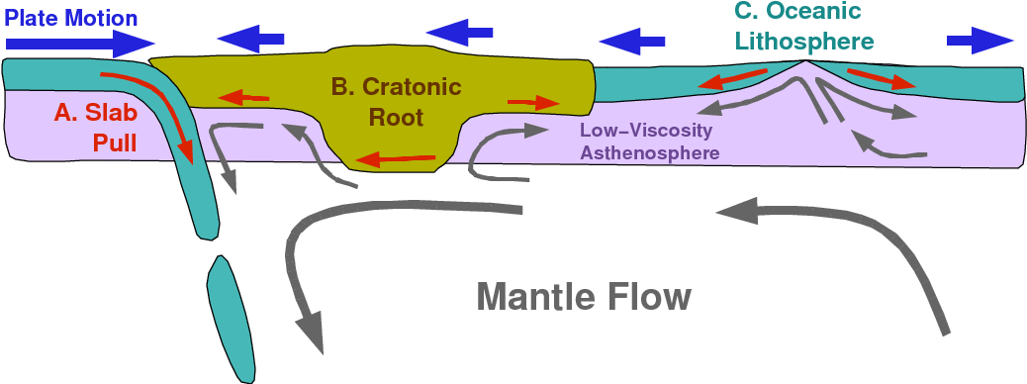
Predictions of
Numerical
Convection Models:
Lithospheric
Stresses
Lithgow-Bertelloni &
Guynn, 2004

Slide 26
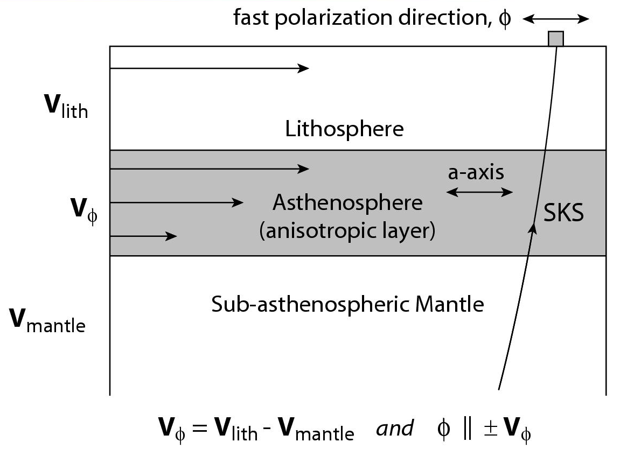
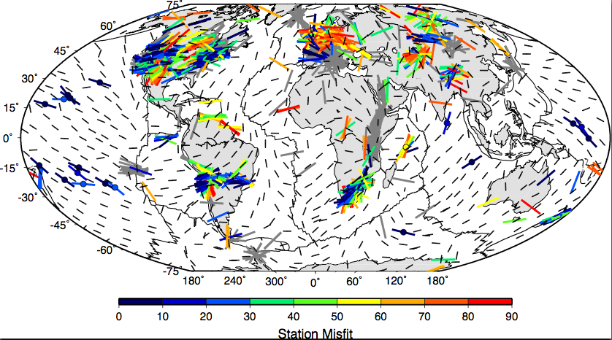
Predictions of Numerical
Convection Models:
Anisotropic Fabric
Conrad
et al.,
2007

Slide 27
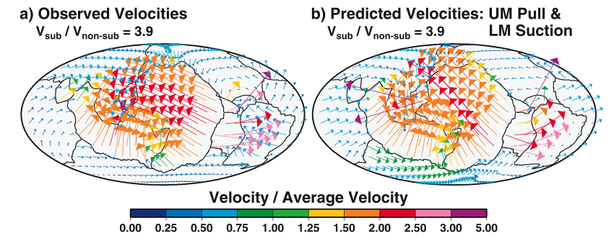
Predictions of Numerical
Convection Models:
Plate Motions
Conrad & Lithgow-Bertelloni [2004]

Slide 28
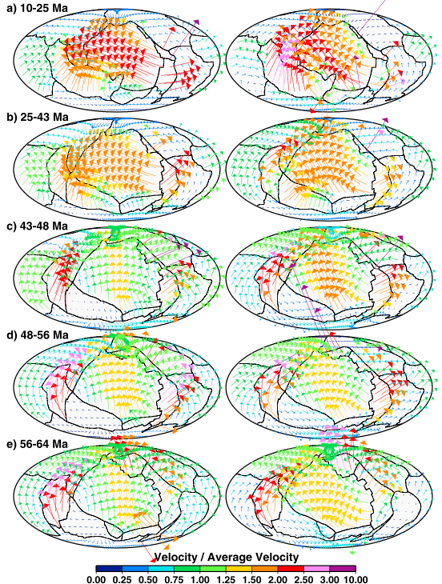
Observed
Predicted
Predictions of
Numerical
Convection Models:
Time-Dependence
of Plate Motions
Conrad &
Lithgow-Bertelloni [2004]

Slide 29
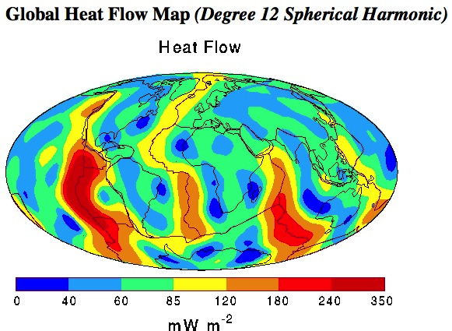
Thermal Evolution
of the Earth
1862: Lord Kelvin
How long would an initially
molten earth take to cool at
present cooling rates?
20 to 100 Million years
1895: John Perry
But the mantle is convecting:
2 to 3 Billion Years
1898: Marie Curie Discovered Radioactivity:
New internal heat source changes everything!
Most important elements for Earth:
Potassium, Thorium, Uranium
Earth internal heat budget it still a research topic today

Slide 30
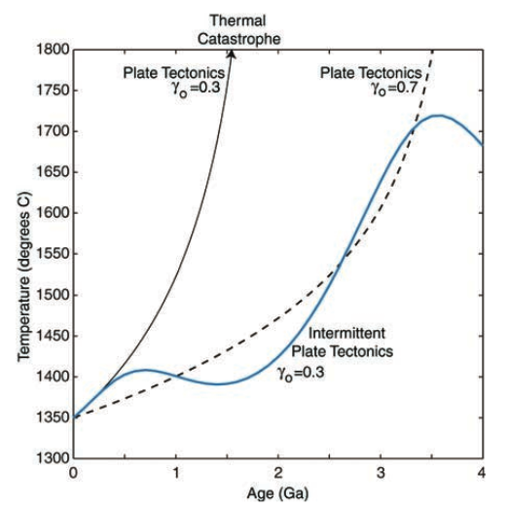
Current thinking:
→ Estimated
volume of heat
producing elements
is small:
→ Earth cools too
rapidly
→ Possible Solution:
Plate tectonics is
less efficient than
we think?
More heat
producing
elements
Silver & Behn [2008]

