Slide 1
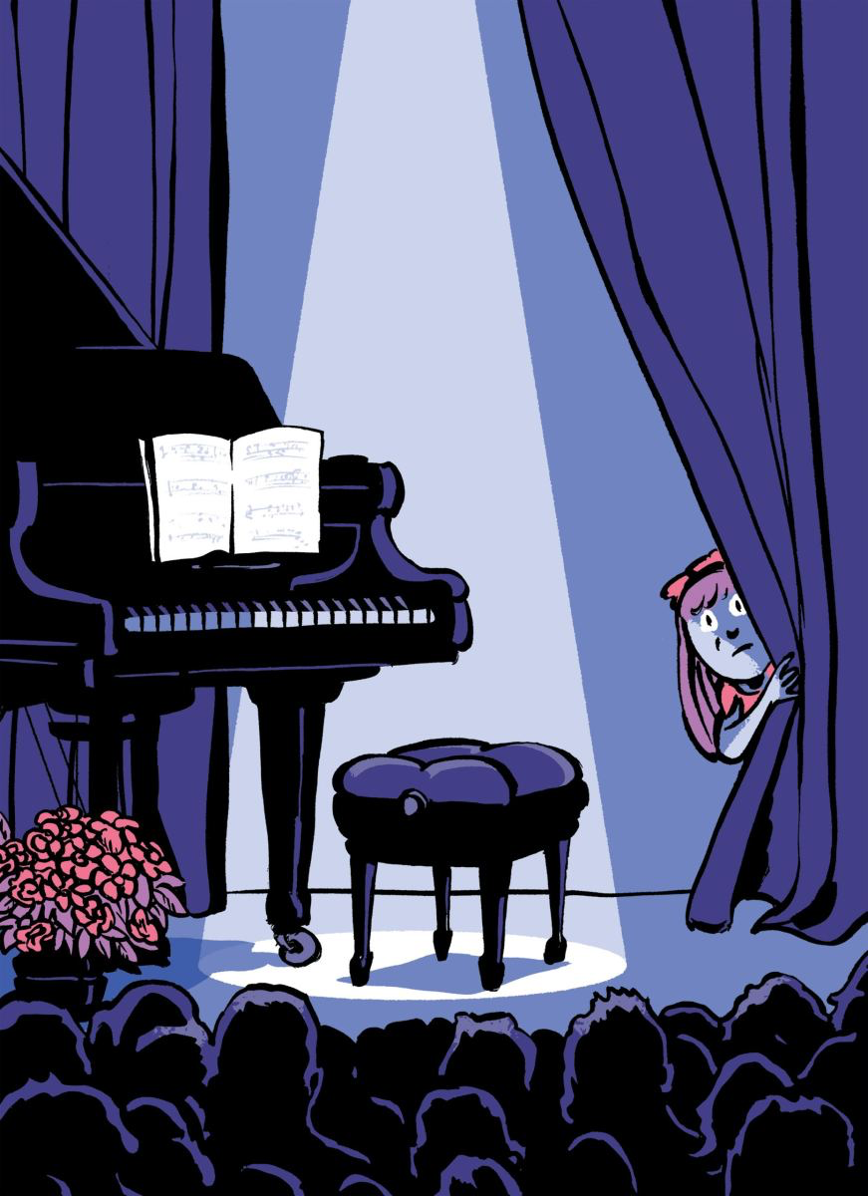
Assigned Reading (on the class website):
I Can’t Go On!
What’s behind stagefright?
By Joan Acocella
A review of:
“Playing Scared: A History and
Memoir of Stage Fright”
The New Yorker, Aug. 3, 2015
Questions to consider: 1. Do scientists get stagefright?
2. How is a scientific presentation
similar to an artistic performance? How is it different?

Slide 2
Assigned Reading (on the class website):
I Can’t Go On!
What’s behind stagefright?
By Joan Acocella
Factors that breed stagefright
A “culture” of performers not caring about the audience
Media vehicles that don’t require live performance
Intense pressure to perform at a high level every time
Public display of private emotions (exposure)
Shyness – many performers learned by practicing in private
Awkwardness - many performers are not social people
How many of these are relevant for scientists?

Slide 3
Assigned Reading (on the class website):
I Can’t Go On!
What’s behind stagefright?
By Joan Acocella
Ways to combat stagefright
Beta – blockers (?!?)
Yoga / meditation
Techniques to think positive thoughts / build confidence
Techniques to “center yourself” or “focus”
Realize that there is no cure for stagefright
Use nervousness as a proof that you are serious
How many of these are relevant for scientists?

Slide 4
Assigned Reading (on the class website):
I Can’t Go On!
What’s behind stagefright?
By Joan Acocella
Stagefright: Conclusions
Nervousness is an integral part of public speaking
This is true for scientists too
It affects different people in different ways
There are many ways to handle stagefright – everyone must find their own way

Slide 5
How to Give a Memorable Seminar
Consider your message
Every talk should make only one main point.
Make sure everything you say relates to that point.

Slide 6
How to Give a Memorable Seminar
Consider your message
Every talk should make only one main point.
Make sure everything you say relates to that point.
What should your audience take home?
Will your audience understand this easily?

Slide 7
How to Give a Memorable Seminar
2. Tell a story
Beginning: What problem are you trying to solve?
Why is this problem important?
How do you plan to solve this problem?

Slide 8
How to Give a Memorable Seminar
2. Tell a story
Beginning: What problem are you trying to solve?
Why is this problem important?
How do you plan to solve this problem?
Middle: Describe your method.
Show your results / discoveries.
Make sure everything you say is relevant

Slide 9
How to Give a Memorable Seminar
2. Tell a story
Beginning: What problem are you trying to solve?
Why is this problem important?
How do you plan to solve this problem?
Middle: Describe your method.
Show your results / discoveries.
Make sure everything you say is relevant
End: What are the implications of your work?
Highlight a few main conclusions.

Slide 10
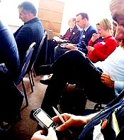
How to Give a Memorable Seminar
3. Never Run Overtime! (EVER!)
It may be the only thing your audience remembers
After a few minutes overtime, your
audience may look like this ➔

Slide 11
How to Give a Memorable Seminar
3. Never Run Overtime! (EVER!)
Strategies to avoid running too long:
→ Practice your talk (and time yourself)
→ Know how long you typically spend on each slide
(I spend about 1 minute per slide on average)
→ Prepare your talk carefully:
Cut out unnecessary material
Update your talk each time you give it.
→ Simplify (figures, concepts, conclusions) to make
sure your message is easily understood

Slide 12
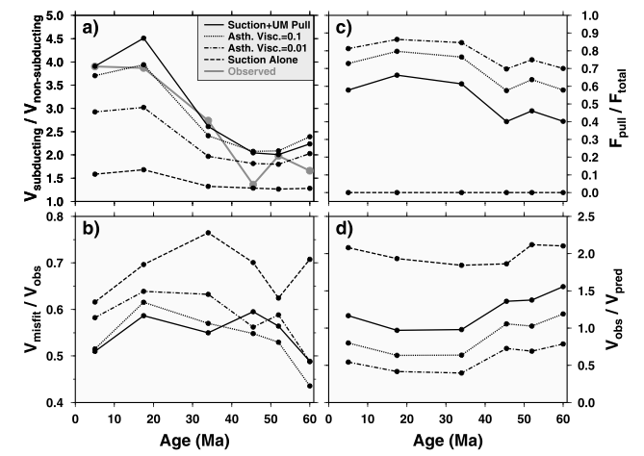
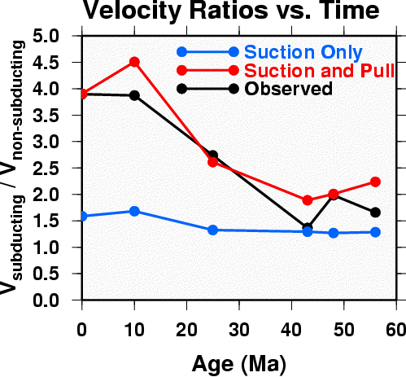
How to Give a Memorable Seminar
4. Figures should be clear
Axes and labels should be easy to read.
From a paper:
For a talk:

Slide 13
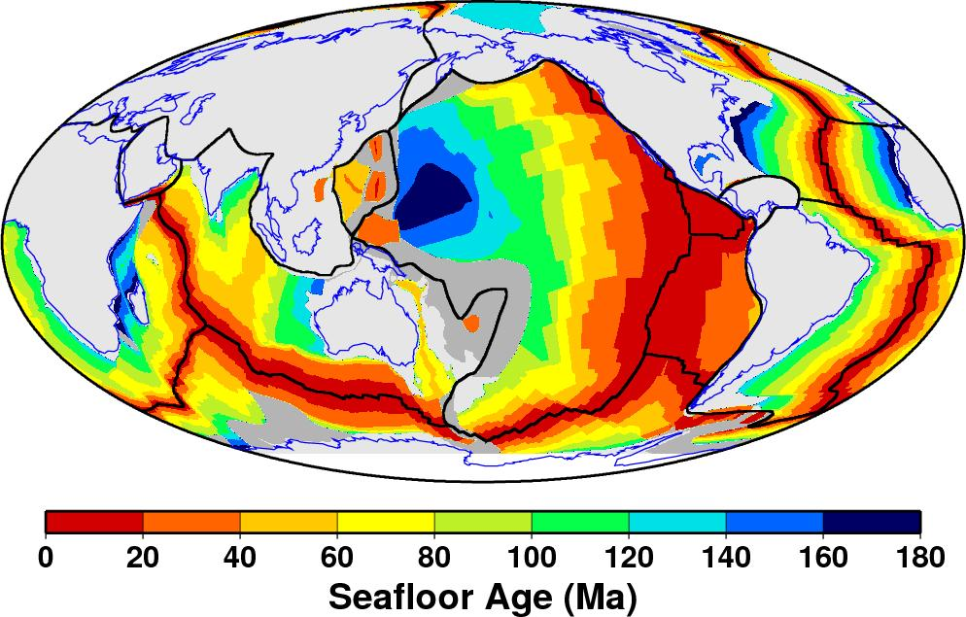
How to Give a Memorable Seminar
5. Avoid equations (or at least be careful)
Focus on the equations’s meaning.
Make the equation simple.
From a paper:
For a talk:

Slide 14
How to Give a Memorable Seminar
Avoid Distractions
Examples of Distractions:
Distracting background
Unnecessary graphics
Extra text that you don’t refer to, is too
long, or that is not so very relevant
Obvious nervousness
A waving pointer

Slide 15
How to Give a Memorable Seminar
Avoid Distractions
Examples of Distractions:
• Distracting background
• Unnecessary text or graphics
• Obvious nervousness
• A waving pointer
• Clothing (?)
Keep the focus on what you are saying

Slide 16
How to Give a Memorable Seminar
7. A talk is a performance
Delivery:
Face the audience
Speak clearly and loud enough

Slide 17
How to Give a Memorable Seminar
7. A talk is a performance
Delivery:
Face the audience
Speak clearly and loud enough
Attitude:
Project confidence
Be enthusiastic

Slide 18
How to Give a Memorable Seminar
7. A talk is a performance
Delivery:
Face the audience
Speak clearly and loud enough
Attitude:
Project confidence
Be enthusiastic
Rapport:
Relate to your audience
Interact with your audience

Slide 19
How to Give a Memorable Seminar
7. A talk is a performance
Delivery:
Face the audience
Speak clearly and loud enough
Attitude:
Project confidence
Be enthusiastic
Rapport:
Relate to your audience
Interact with your audience
Entertain:
Don’t be boring!
Be careful with jokes

Slide 20
How to Give a Memorable Seminar
Start out well
Your first few sentences set a tone that can last
(Memorize them?)

Slide 21
How to Give a Memorable Seminar
9. Avoid boring or confusing slides.
Example: An outline of your seminar
Outline of my seminar about public speaking
Introduction Why public speaking is important
Methods How to get better at public speaking
Results How to evaluate your public speaking
Conclusions What to expect as you get better at public speaking

Slide 22
How to Give a Memorable Seminar
9. Avoid boring or confusing slides.
Example: An excerpt from a long passage
Public Speaking (from Wikipedia)
In public speaking, as in any form of communication, there are five basic elements, often expressed as "who is saying what to whom using what medium with what effects?" The purpose of public speaking can range from simply transmitting information, to motivating people to act, to simply telling a story. Good orators should not only be able to engage their audience, but also able to read them. The power of a truly great presenter is the ability to change the emotions of their listeners, not just inform them. Public speaking can also be considered a discourse community. Interpersonal communication and public speaking have several components that embrace such things as motivational speaking, leadership/personal development, business, customer service, large group communication, and mass communication. Public speaking can be a powerful tool to use for purposes such as motivation, influence, persuasion, informing, translation, or simply ethos.
In current times, public speaking for business and commercial events is often done by professionals, with speakers contracted either independently, through representation by speakers bureau paid on commission of 25-30%, or via other means.

Slide 23
How to Give a Memorable Seminar
10. Anticipate questions
Always be respectful of the questioner.
HOWEVER: Make sure they are also respecting you.

Slide 24
How to Give a Memorable Seminar
10. Anticipate questions
Always be respectful of the questioner.
HOWEVER: Make sure they are also respecting you.
Don’t allow questioning to take over your talk.
Remember, you are in control of the room.

Slide 25
How to Give a Memorable Seminar
10. Anticipate questions
Always be respectful of the questioner.
HOWEVER: Make sure they are also respecting you.
Don’t allow questioning to take over your talk
Remember, you are in control of the room.
Use questions to highlight your main points.

Slide 26
How to Give a Memorable Seminar
10. Anticipate questions
Always be respectful of the questioner.
HOWEVER: Make sure they are also respecting you.
Don’t allow questioning to take over your talk
Remember, you are in control of the room.
Use questions to highlight your main points.
Be prepared for critical questions:
At least know answers to your own questions about your work
Prepare extra slides to help you answer expected questions
Acknowledge if you don’t know the answer

Slide 27
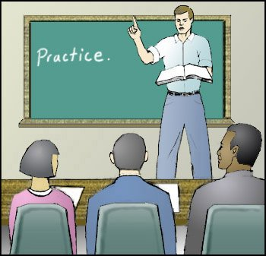
How to Give a Memorable Seminar
11. Practice!!
Work out transitions
Find efficient ways
to make your point
Practice with a group
and get feedback

Slide 28
How to Give a Memorable Seminar
12. Finally: Enjoy it!
Each seminar is a chance to:
Connect with new people
Improve your public speaking skills
Having the attention
of this many people
is a rare opportunity.

